Slide 1
Opioids and Substances of Misuse among First Nations people in Alberta
Bruce McDonald, Government of Alberta
Bonnie Healy, Alberta First Nations Information Governance Centre
Wednesday November 22, 2017

Slide 2
Alberta’s Opioid Crisis
The opioid crisis has had an impact across the province.
Current surveillance demonstrates the complexity of opioid use/substances of misuse
Various populations are impacted in different ways

Slide 3
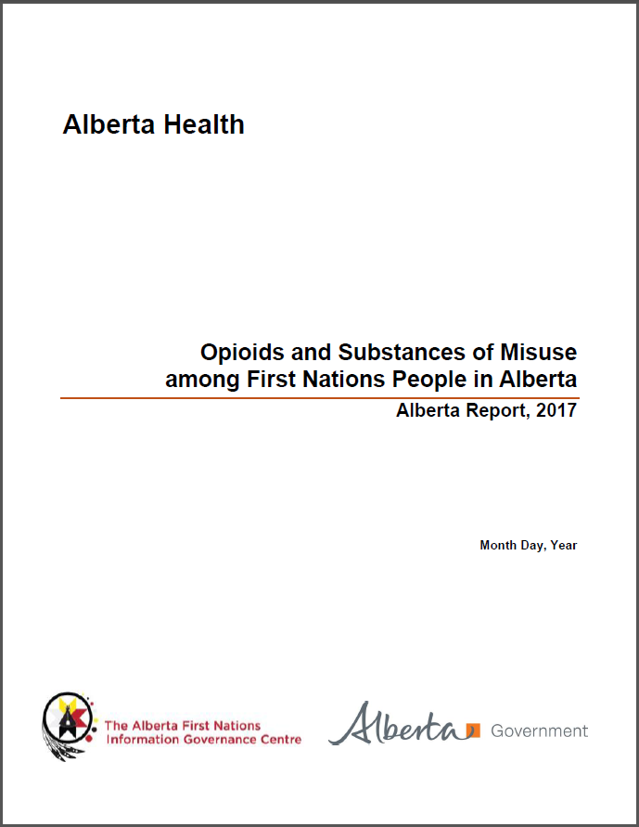
Report
Through key partnerships, we identified a way forward in compiling a First Nations-specific opioid report
This report demonstrates how this Alberta wide issue presents itself in First Nations people.

Slide 4
Report
Report includes:
Apparent accidental opioid toxicity deaths
Confirmed accidental and suicide drug & alcohol toxicity deaths
Related healthcare utilizations (emergency department visits, hospitalizations, EMS responses)
Drug dispensations (opioid and opioid agonist therapy)

Slide 5
Report
Requirements for compilation:
Respectful processes
Data details:
Death classifications (Medical Examiner)
Identification of First Nations people

Slide 6
Drug toxicity death data-vital stats
Limitations of Vital Statistics data currently available to Alberta Health:
Death Certificates are coded (ICD-10) by Health Canada-records are delayed by about two years.
Cause of death ICD-10 codes lacks specificity, limited to three digit ICD-10 (i.e. “drug poisoning”)

Slide 7
Medical Examiner data
More recent cases can be identified, including open/pending cases using toxicology results
More specific information available for reporting:
Cause of death (i.e. substances causing death)
Circumstances of deaths (i.e. individual using alone)
Place of death/overdose (i.e. home/hotel etc.)

Slide 8
Medical Examiner data-First Nations identification
The Medical Examiner does not identify ethnicity or Indigenous status
Place of death/home address information does not reliably capture on or off reserve

Slide 9
Alberta Health-First Nations identification
Alberta Health Care Insurance Plan Registry
First Nations identifying information
Medical Examiner data
First Nations individuals identified

Slide 10
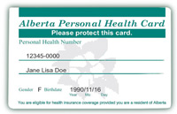
Data availability:
First Nations identifying information
A list is provided by First Nations representatives
Alberta Health Care Insurance Plan Registry

Slide 11
Data availability:
X
?
$
2009
No additional external information
2017
Health premiums eliminated
First Nations identifiers less reliable

Slide 12
Data availability:
Implications and current limitations
Currently limited ability identify people affiliated with a specific band in recent years (after around 2010)
Limited ability to identify on/off reserve
Information used to compiled First Nations-specific info currently based on First Nations who have ‘Status’
Not able to identify First Nations client at point of care
Reserve
Postal code

Slide 13
Report findings
First Nations people in Alberta compared to non-First Nations people:
Rate of opioid toxicity deaths were 3x higher
Rate of emergency department visits related to opioids and substances of misuse were 6x higher
Rate of hospitalizations related to opioids and substances of misuse were 5x higher
Rate of EMS responses to opioid related events in Edmonton and Calgary were 7x higher
Rate of opioid dispensing from community pharmacies was 2x higher

Slide 14
Opioid toxicity deaths
 | First Nations |  | Non-First Nations
 | Count | Percent of total deaths | Count | Percent of total deaths | Total
2016 | 71 | 13% | 489 | 87% | 560
2017 (Jan 1-Mar 31) | 16 | 11% | 125 | 89% | 141
Total | 87 | 12% | 614 | 88% | 701

Slide 15
Opioid toxicity deaths
 | First Nations |  | Non-First Nations
 | Count | Proportion | Count | Proportion
South | 9 | 10% | 26 | 4%
Calgary | 41 | 47% | 245 | 40%
Central | 5 | 6% | 74 | 12%
Edmonton | 24 | 28% | 220 | 36%
North | 8 | 9% | 49 | 8%
Total | 87 | 100% | 614 | 100%
 | First Nations |  | Non-First Nations
 | Count | Proportion | Count | Proportion
Calgary | 29 | 33% | 226 | 37%
Edmonton | 21 | 24% | 187 | 30%
Red Deer | 2 | 2% | 34 | 6%
Fort McMurray | 0 | 0% | 14 | 2%
Grande Prairie | 2 | 2% | 14 | 2%
Lethbridge | 5 | 6% | 12 | 2%
Medicine Hat | 0 | 0% | 8 | 1%
Other AB locations | 28 | 32% | 119 | 19%
Total | 87 | 100% | 614 | 100%

Slide 16
Opioid toxicity deaths
First Nations people
51% 23% 30-34 age group
Non-First Nations people
76% 25% 30-34 age group
First Nations people
49% 11% 50-54 age group
Non-First Nations people
24% 23% 50-54 age group

Slide 17
Drug toxicity deaths-
Percentage difference in opioid dispensing (unique individuals with at least one dispensation) by First Nations status, Alberta, between 2013 and 2017.

Slide 18
Opioid agonist therapy dispensing
Percentage difference in opioid agonist therapy (OAT) drug dispensing rate (unique individuals with at least one dispensation) by First Nations status, Alberta, between 2013 and 2017.

Slide 19
Emergency Department visits
Rate of emergency department (ED) visits related to opioid use and other substances of misuse per 100,000 person years, by First Nations (FN) status and Zone. 2014 to 2016..

Slide 20
Hospitalizations
Rate of hospitalizations related to opioid use and other substances of misuse per 100,000 person years, by First Nations status and Zone. 2014 to 2016.

Slide 21
Questions
?

